Slide 1


Implementing Federal Blockchain in E-Voting: A Revolutionary Approach to Transparent and Secure Elections
Thesis Pre-Defense – Spring 2025
22 January 2025
Presented by-
A – 12345
B – 123456
C – 1234567
Supervisors-
Dr. Md Ahsan Habib, Professor
Sudip Ghoshal, Lecturer
Department of Computer Science and Engineering
Green University of Bangladesh

Slide 2


Table of Contents
Introduction
What is Blockchain?
Problem Statement
Related Works
Motivation
Objective
Proposed Architecture
Dataflow Diagram
Methodology
Grant Chart
Budget Plan
Conclusion
Reference
01
18-04-25
Implementing Federal Blockchain in E-Voting: A Revolutionary Approach to Transparent and Secure Elections

Slide 3
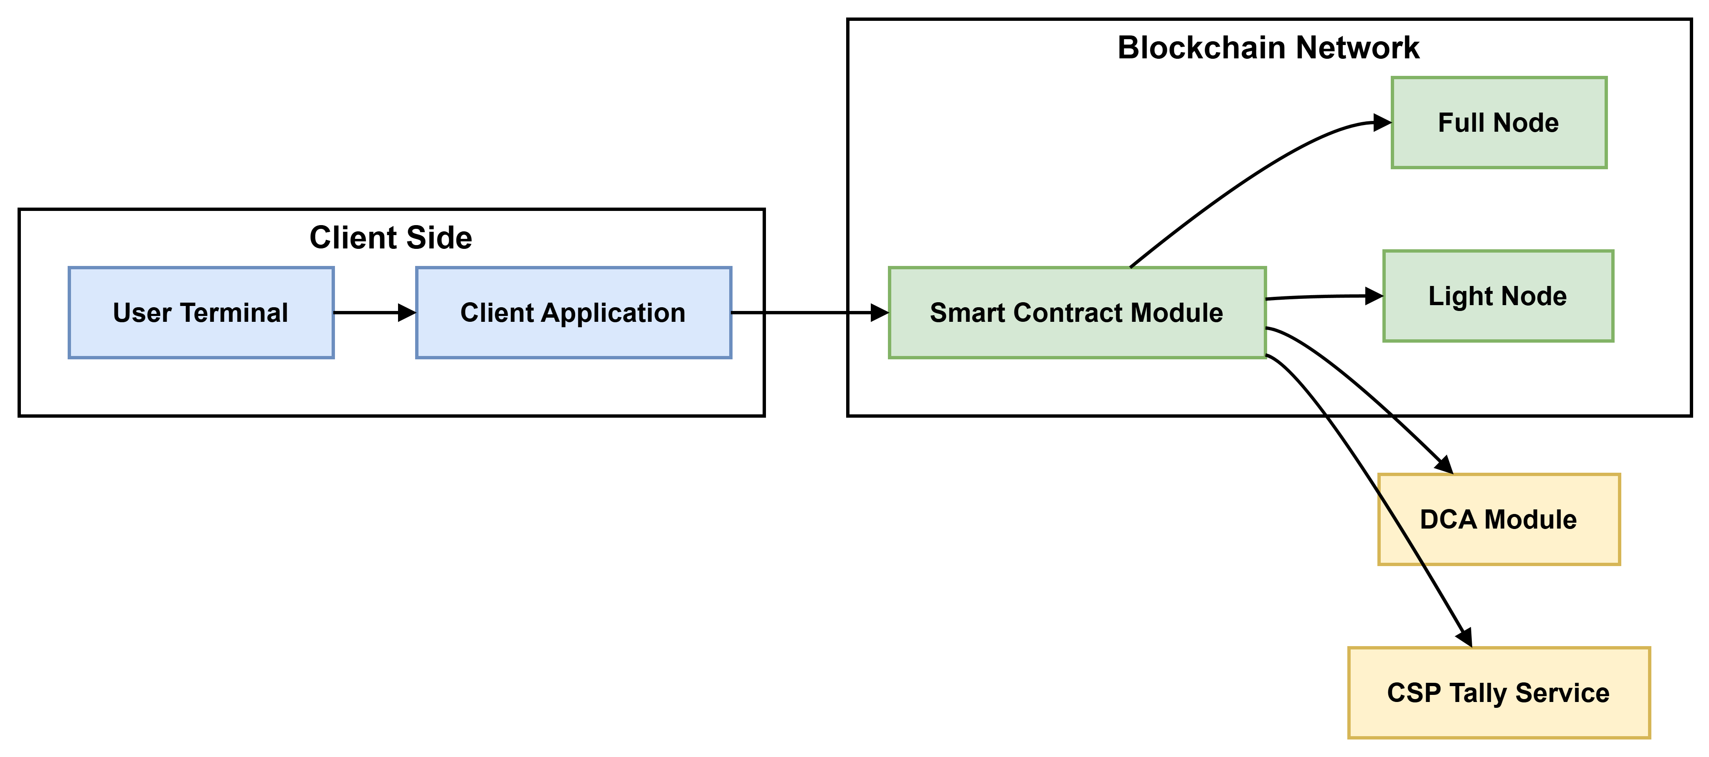
Introduction
E-voting replaces slow, error-prone paper ballots, reduces resource waste, and minimizes manual tallying mistakes. It broadens voter access, allowing voting from anywhere at any time.
Current systems often rely on single layer authentication and lack liveness checks, increasing impersonation risks.
Blockchain technology enhances e-voting with tamper-evident votes, automated tallying, and real-time results.
Our E-Voting system addresses these issues with live biometric authentication, double-layer security, secret-sharing, and efficient tallying. This ensures stronger voter identity, public verifiability, and scalable performance.
Figure 1: Component diagram
02
18-04-25
Implementing Federal Blockchain in E-Voting: A Revolutionary Approach to Transparent and Secure Elections

Slide 4
What is Blockchain?
Block n
A blockchain is a distributed database that maintains a keep-growing list of ordered records called blocks.
Header
Header: Combine all the above elements.
Timestamp: Add block creation time.
Previous Hash: Link with the prior block's hash.
Data: Input transaction or block data.
Hash: Apply SHA-256 to generate a unique block hash.
Nonce: Use for proof-of-work adjustments.
Merkle Root: Summarize all transactions.
Timestamp
Previous Hash
Data
Hash Calculated
Nonce
Merkel Root
03
18-04-25
Implementing Federal Blockchain in E-Voting: A Revolutionary Approach to Transparent and Secure Elections

Slide 5
Problem Statement
How can we implement real‑time liveness detection for fingerprint and iris enrollment that reliably blocks spoofing without degrading user experience?
What protocol design seamlessly fuses on‑the‑fly biometric verification with ring‑signature proofs to ensure anonymous, unforgeable vote casting?
How can we extend and formally verify blockchain smart contracts to audit hashed biometric templates on‑chain while preserving data confidentiality and integrity?
How do we derive and optimize closed‑form time complexity bounds for each phase of the biometric‑blockchain workflow to guarantee real‑time scalability?
06
18-04-25
Implementing Federal Blockchain in E-Voting: A Revolutionary Approach to Transparent and Secure Elections

Slide 6
Related Work
07
18-04-25
Implementing Federal Blockchain in E-Voting: A Revolutionary Approach to Transparent and Secure Elections

Slide 7
Related Work
Research Name | Contributions | Limitations
10
18-04-25
Implementing Federal Blockchain in E-Voting: A Revolutionary Approach to Transparent and Secure Elections

Slide 8
Motivation
Single‑Factor Proofing Risk:
Relies solely on DCA‑issued credentials.
Absence of additional identity checks leaves the system vulnerable to impersonation.
Biometric Liveness Integration: Fingerprint and iris modalities verify a voter’s physical presence and Real‑time liveness detection.
Double‑Layer Authentication:
Something You Are.
Something You Have.
Scalability Through Complexity Analysis: Establish closed‑form time‑complexity for enrollment, verification, hashing, and on‑chain submission.
11
18-04-25
Implementing Federal Blockchain in E-Voting: A Revolutionary Approach to Transparent and Secure Elections

Slide 9
Objective
Develop liveness‑checked enrollment for fingerprint and iris biometrics.
Specify a double‑layer cast‑time protocol combining biometric and ring‑signature proofs.
Extend and formally verify SC (smart contracts) for secure on‑chain storage and audit of biometric hashes.
Derive closed‑form time complexity bounds for each phase and optimize bottlenecks.
12
18-04-25
Implementing Federal Blockchain in E-Voting: A Revolutionary Approach to Transparent and Secure Elections

Slide 10
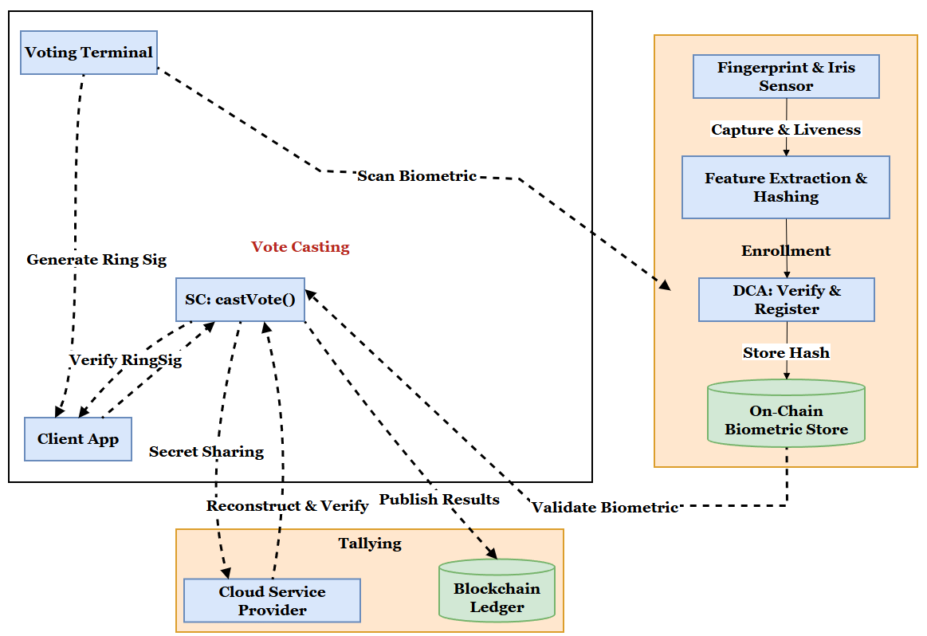
Proposed Architecture
This diagram shows the three operational phases enrollment, vote casting, and ballot tallying highlighting interactions between physical sensors, on‑chain stores, smart contracts, and off‑chain tally services.
13
Figure 2: Proposed Architecture
18-04-25
Implementing Federal Blockchain in E-Voting: A Revolutionary Approach to Transparent and Secure Elections

Slide 11
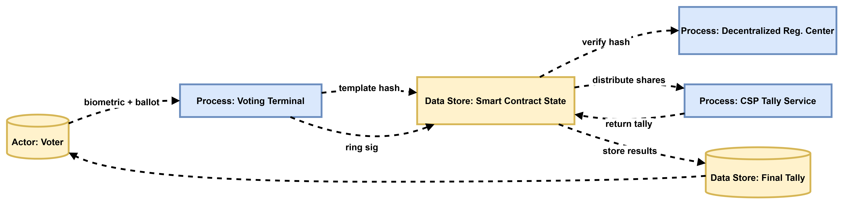
Data Flow Diagram
Figure 3: Data Flow Diagram
The DFD clarifies data storage elements and process flows, ensuring each artifact (hash, signature, shares) is accounted for in governance and auditing.
14
18-04-25
Implementing Federal Blockchain in E-Voting: A Revolutionary Approach to Transparent and Secure Elections

Slide 12
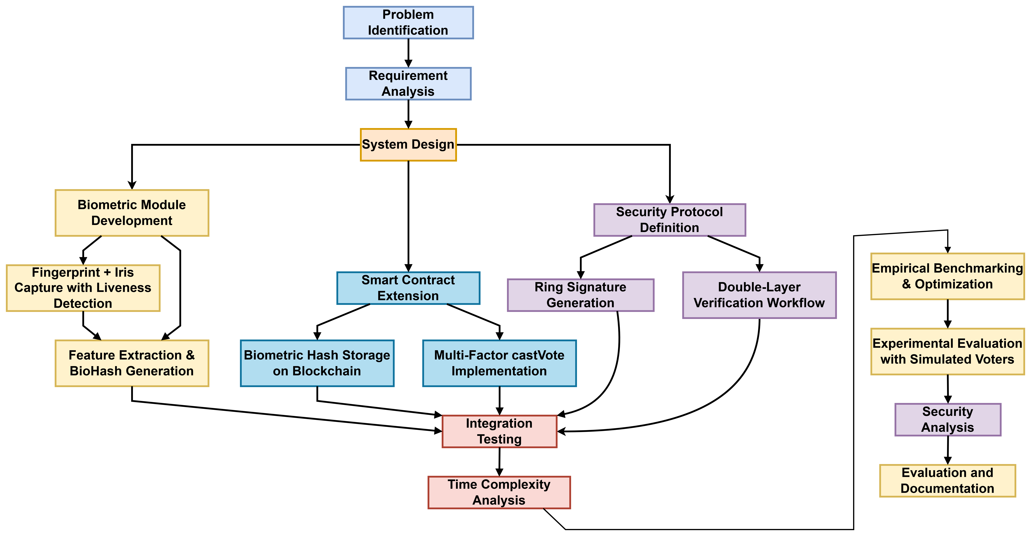
Methodology
15
Figure 4: Methodology
18-04-25
Implementing Federal Blockchain in E-Voting: A Revolutionary Approach to Transparent and Secure Elections

Slide 13
Grant Chart
16
18-04-25
Implementing Federal Blockchain in E-Voting: A Revolutionary Approach to Transparent and Secure Elections

Slide 14
Budget Table
Points | Item | Unit | No. of Unit | Per Unit Cost (Tk) | Duration (Month) | Total Cost (BDT-Tk)
01 | Data Collection | Travel & Testing
02 | Blockchain Setup | Cloud-based blockchain nodes (AWS / Azure)
03 | Hardware | Laptop & IoT Devices
04 | Publication | Conference / Journal Fees
05 | Software Tools | Dev Tools ( Colab Pro )
06 | Hosting & Domain | Hosting for certificate verification portal
07 | Miscellaneous | General Expenses (Print)
Total
17
18-04-25
Implementing Federal Blockchain in E-Voting: A Revolutionary Approach to Transparent and Secure Elections

Slide 15
Conclusion
The thesis contributions and finds that live biometrics and double-layer verification can be implemented in blockchain e-voting with tolerable overhead, and recommends investigating zero-knowledge biometric proofs, geo-distributed tallies via hierarchical secret sharing, and real-world pilot studies with human subjects.
20
18-04-25
Implementing Federal Blockchain in E-Voting: A Revolutionary Approach to Transparent and Secure Elections

Slide 16
Reference
[1] ABC(2022) DOI: 10.1109/ACCESS.2023.3289598
[2]
[3]
[4]
[5]
21
18-04-25
Implementing Federal Blockchain in E-Voting: A Revolutionary Approach to Transparent and Secure Elections

Slide 17
Thank You
18-04-25
Implementing Federal Blockchain in E-Voting: A Revolutionary Approach to Transparent and Secure Elections

Slide 18
Any Questions
?

